Slide 1
Prediction of Presence of Diabetes
Name: Kartik Ningaraj Yanigar
Email: kartik.nyanigar.mec20@itbhu.ac.in
Ph No: 8867021358
This is project for Internships at Exposys Data Labs

Slide 2
ABSTRACT
A machine learning model is a computer program trained to recognize specific patterns. You teach a model on a set of data and give it an algorithm to use to reason about and learn from that data.
Once the model has been trained, you can use it to reason over data it hasn't seen before and make predictions about it. Here this concept has been used to predict the profits of a company based on some already given features.

Slide 3
Table of Contents
Introduction
Existing method
Proposed Method with Architecture
Methodology
Implementation
Conclusion

Slide 4
Introduction
Diabetes is a type of chronic disease which is more common among the people of all age groups. Predicting this disease at an early stage can help a person to take the necessary precautions and change his/her lifestyle according to either prevent the occurrence of this disease or control the disease.
In this project we will be using the dataset called “Pima Indians Diabetes Database” by UCI Machine Learning Repository. This dataset is originally from the National Institute of Diabetes and Digestive and Kidney Diseases. The dataset has been extracted from kaggle.com and the dataset has been uploaded by UCI Machine Learning Repository.
The dataset contains given features-
Pregnancies - showing the number of pregnancies a person had had.
Glucose - Glucose level of the person.
Blood Pressure
Skin Thickness
Insulin – Insulin level of person’s blood.
BMI – Body Mass Index of the person.
Diabetes Pedigree Function – scores of likelihoods of diabetes based on family history given Diabetes Pedigree Function.
Age
Outcome – A binary value (1 or 0) which indicates presence or absence of diabetes.

Slide 5
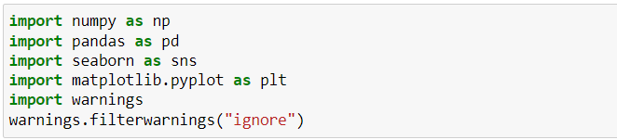
Existing Method
Existing dataset is a dataset with 8 independent variables namely [Pregnancies, Glucose, Blood Pressure, Skin Thickness, Insulin, BMI, Diabetes Pedigree Function, Age] and an dependent variable Outcome (1 or 0) indicating the presence or absence of Diabetes.
Many Classification algorithms can be employed to predict the outcome like Logistic Regression, Support Vector Classifiers, Decision Tree Classifiers,
Logistic Regression and Support Vector Classification are widely used.
Exploring Data
Firstly, importing required libraries to perform basic operations.

Slide 6
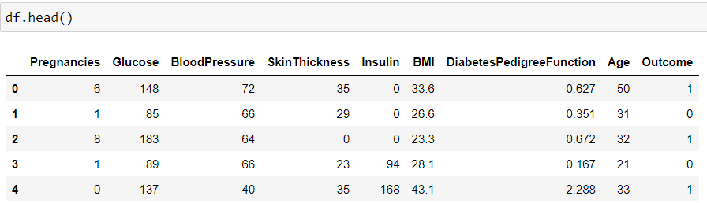
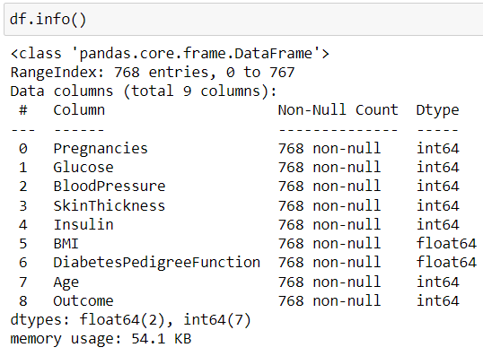
Reading the dataset into pandas’ data frame.
Thus, dataset looks like,
The figure above shows that there are no string or special data types. Thus, only integer and float data types to deal with.

Slide 7
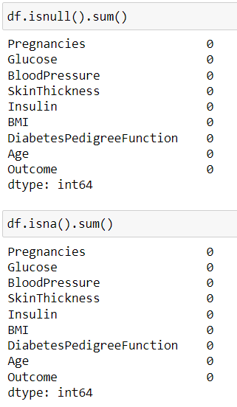
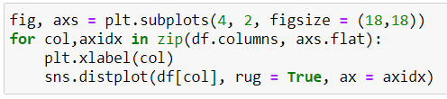
Cleaning Data
We need to consider several factors during data cleaning like duplicate observations, bad labelling, missing or null data points, outliers.
Checking for null values in dataset.
Checking for Outliers in dataset

Slide 8
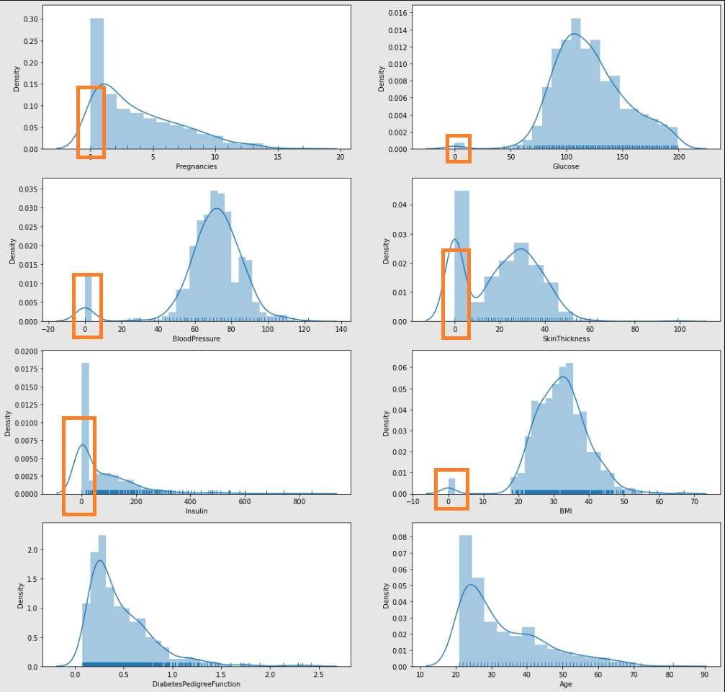
In the above figure the outliers are being indicated within the orange rectangles.

Slide 9
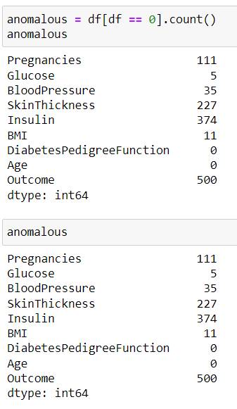
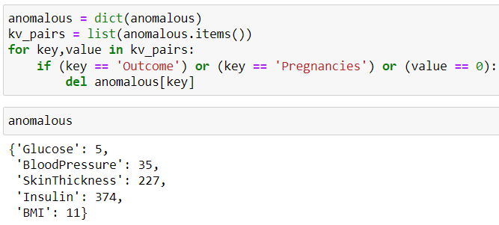
Thus, in above figure the few features have values as zeros whereas it impossible for Glucose levels to be zero, Blood Pressure level to be zero, Skin Thickness to be zero, Insulin to drop to zero, BMI of any person to be zero.
If any features had actually reached a zero level in these features, he or she would surely be dead.

Slide 10
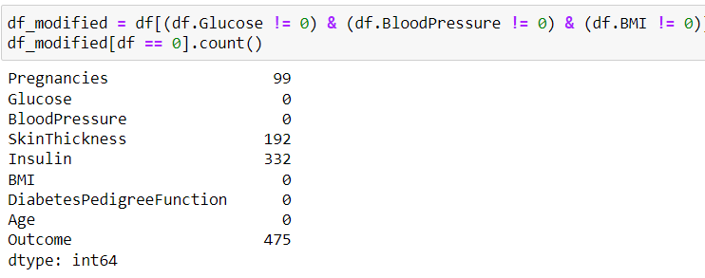
Trying and removing the outliers that have little to no effect on dataset.
But still Skin Thickness and Insulin have zero levels and are not good features to be considered for classification. Thus, we eventually have to perform dimensionality reduction to access best features for classification.

Slide 11
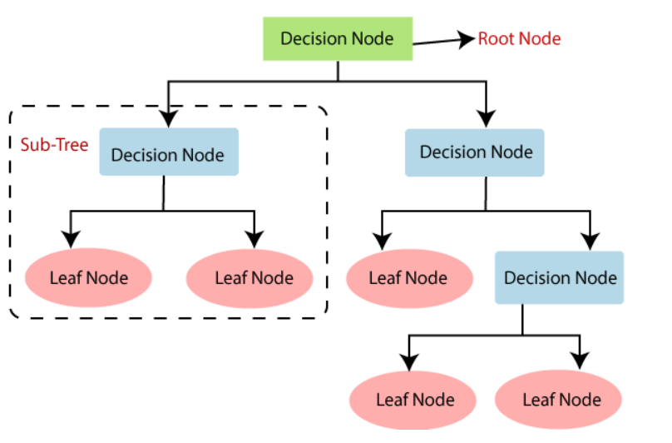
Proposed Method with Architecture
Thus, according to industrial experts Logistic Regression and Support Vector Classification etc. is recommended. But the type of algorithms used depends on the dataset.
In this project Decision Tree Classifier is proposed.
Decision Tree is a Supervised learning technique that can be used for both classification and Regression problems, but mostly it is preferred for solving Classification problems. It is a tree-structured classifier, where internal nodes represent the features of a dataset, branches represent the decision rules and each leaf node represents the outcome.
And Decision Trees can be visualised as:

Slide 12
Methodology
Logistic regression is one of the most popular Machine Learning algorithms, which comes under the Supervised Learning technique. It is used for predicting the categorical dependent variable using a given set of independent variables. Logistic regression predicts the output of a categorical dependent variable. Therefore, the outcome must be a categorical or discrete value. It can be either Yes or No, 0 or 1, true or False, etc. but instead of giving the exact value as 0 and 1, it gives the probabilistic values which lie between 0 and 1.
Logistic regression is one of the most popular Machine Learning algorithms, which comes under the Supervised Learning technique. It is used for predicting the categorical dependent variable using a given set of independent variables. Logistic regression predicts the output of a categorical dependent variable. Therefore, the outcome must be a categorical or discrete value. It can be either Yes or No, 0 or 1, true or False, etc. but instead of giving the exact value as 0 and 1, it gives the probabilistic values which lie between 0 and 1.
Decision Tree is a Supervised learning technique that can be used for both classification and Regression problems, but mostly it is preferred for solving Classification problems. It is a tree-structured classifier, where internal nodes represent the features of a dataset, branches represent the decision rules and each leaf node represents the outcome.
Random Forest is a classifier that contains a number of decision trees on various subsets of the given dataset and takes the average to improve the predictive accuracy of that dataset. Instead of relying on one decision tree, the random forest takes the prediction from each tree and based on the majority votes of predictions, and it predicts the final output.

Slide 13
Gradient Boosting Machine (GBM) is one of the most popular forward learning ensemble methods in machine learning. It is a powerful technique for building predictive models for regression and classification tasks. GBM helps us to get a predictive model in form of an ensemble of weak prediction models such as decision trees. Whenever a decision tree performs as a weak learner then the resulting algorithm is called gradient-boosted trees.
Extremely Randomized Trees Classifier (Extra Trees Classifier) is a type of ensemble learning technique which aggregates the results of multiple de-correlated decision trees collected in a “forest” to output it’s classification result. In concept, it is very similar to a Random Forest Classifier and only differs from it in the manner of construction of the decision trees in the forest.

Slide 14
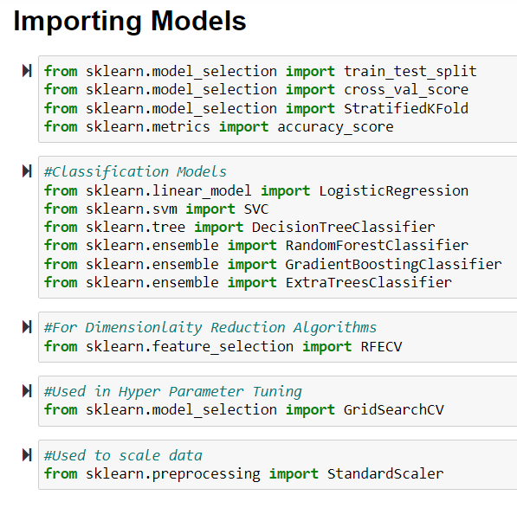
Implementation

Slide 15
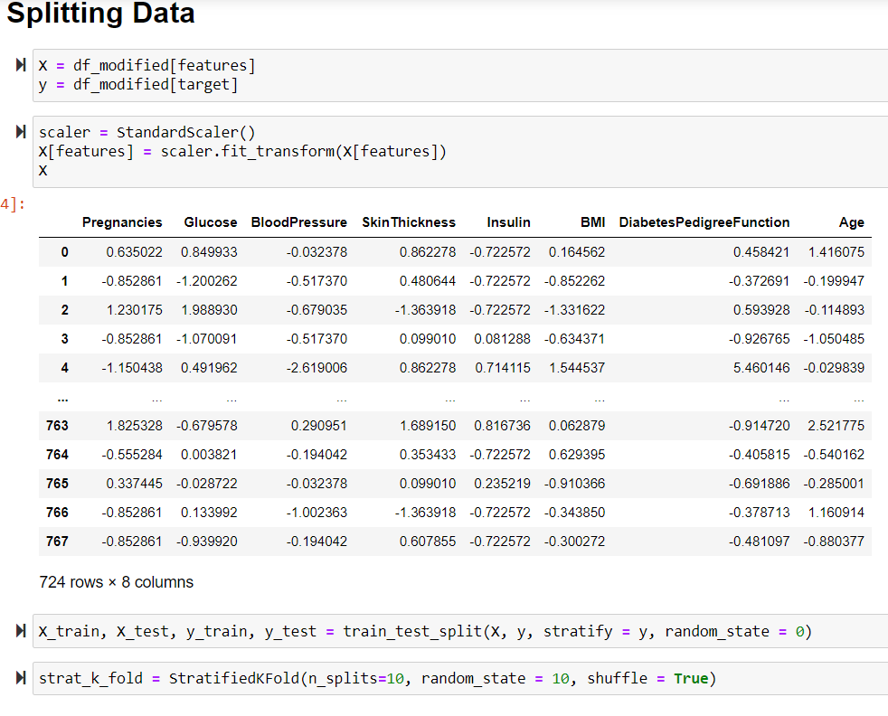

Slide 16
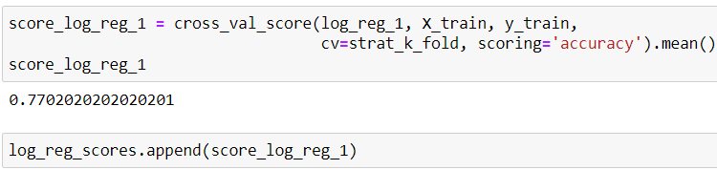
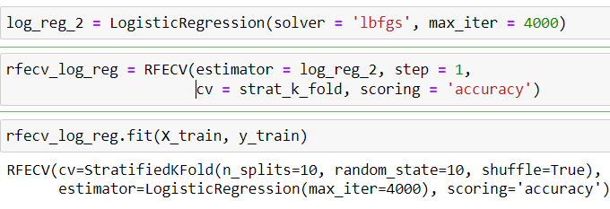
Implementation 1.Logistic Regression
Initial Model:
Initial Score:
Dimensionality Reduction:

Slide 17
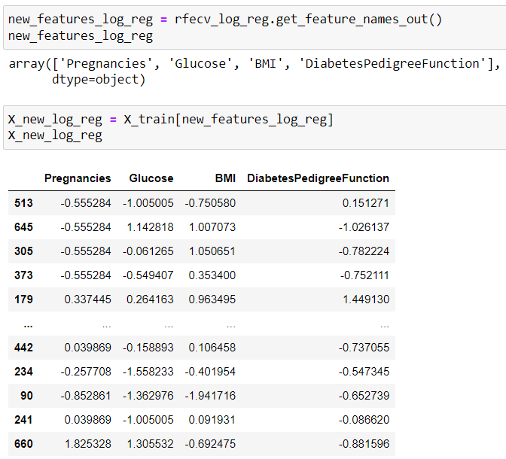

Slide 18
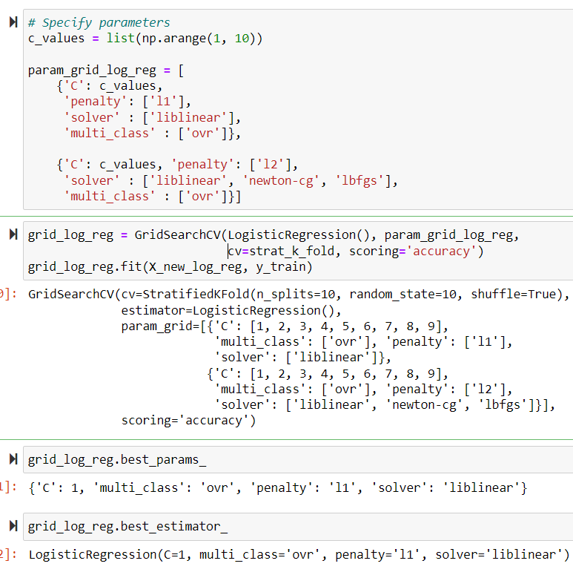
Hyper Parameter Tuning:

Slide 19
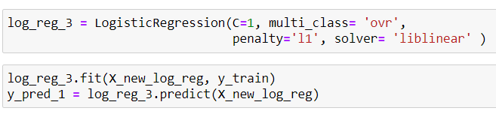
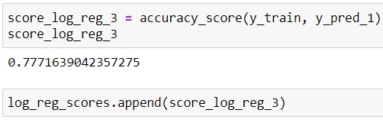
Final Model:
Training Scores:

Slide 20
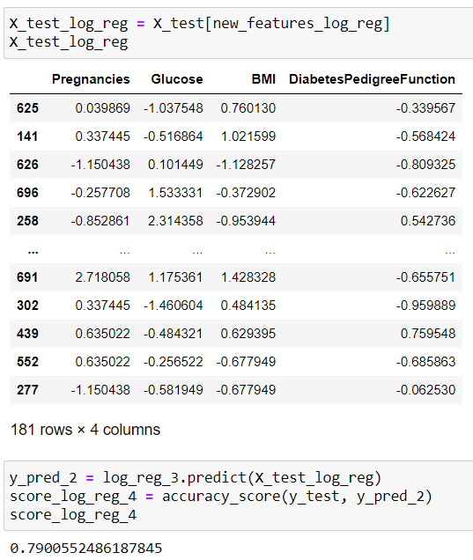
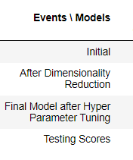
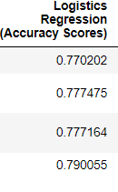
Testing:
Final Scores:

Slide 21
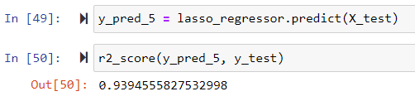
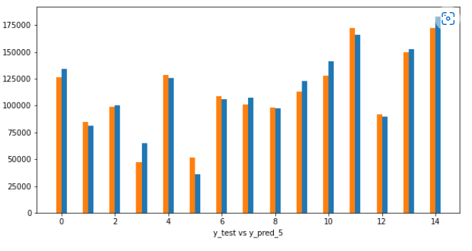
Predicting the target values and R squared value:
Graph of Test Variable and predicted values:

Slide 22

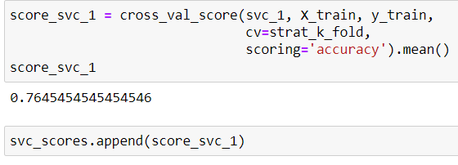
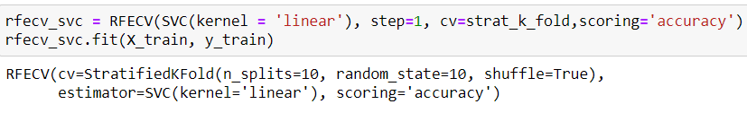
2.Support Vector Classifier
Initial Model:
Initial Score:
Dimensionality Reduction:

Slide 23
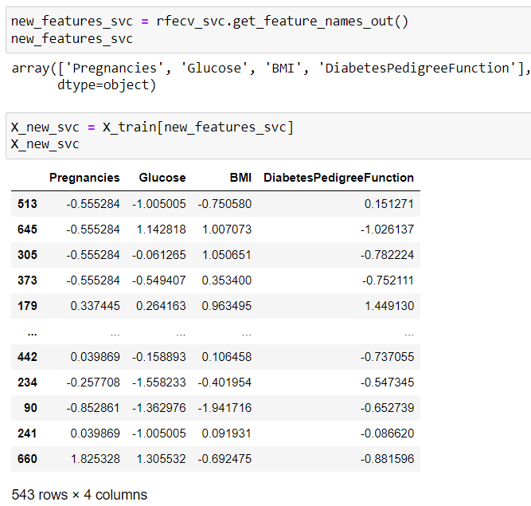

Slide 24
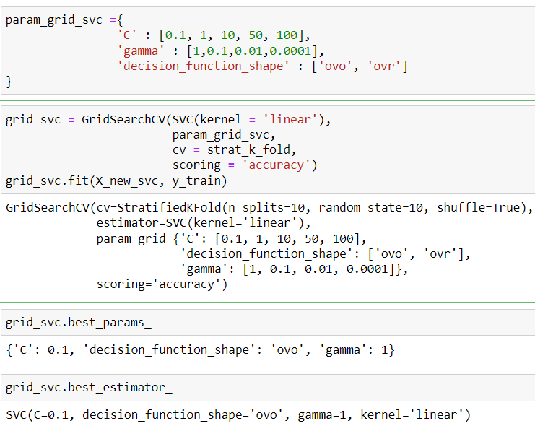
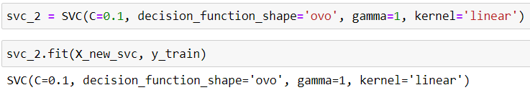
Hyper Parameter Tuning:
Final Model:

Slide 25
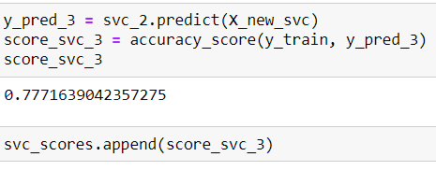
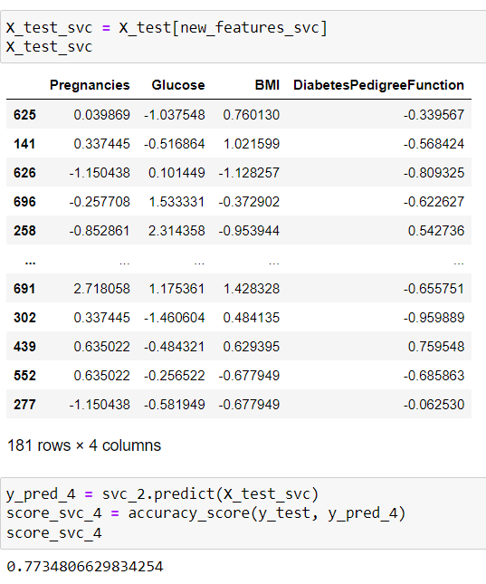
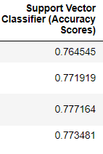
Training Scores:
Testing:
Final Scores:

Slide 26

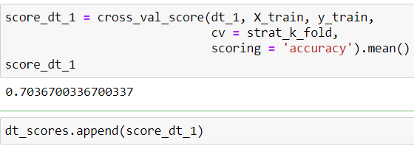
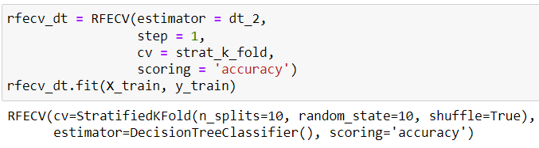
3.Decision Tree Classifier
Initial Model:
Initial Score:
Dimensionality Reduction:

Slide 27
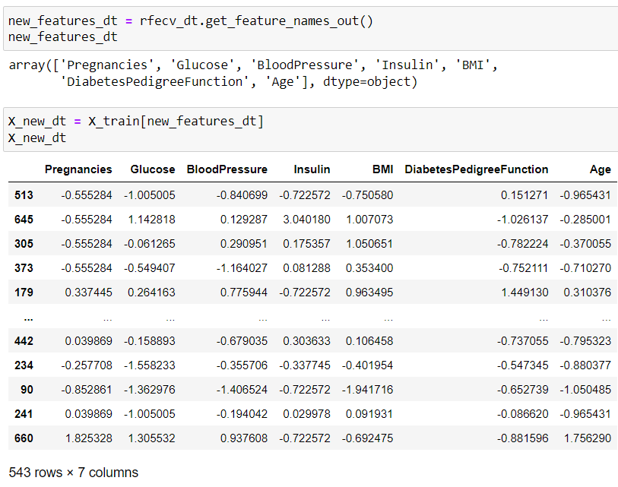

Slide 28
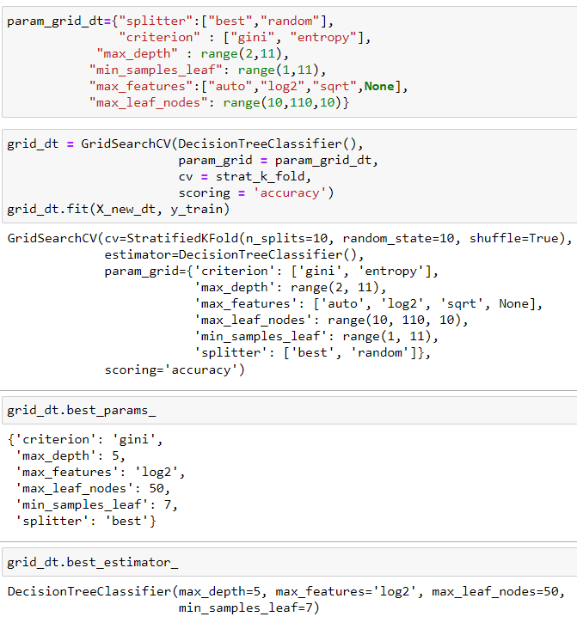
Hyper Parameter Tuning:

Slide 29
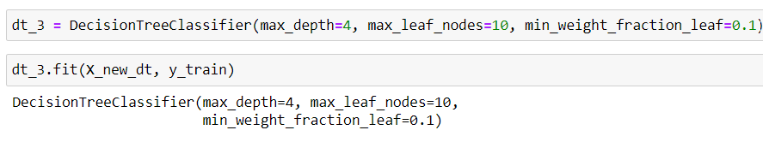
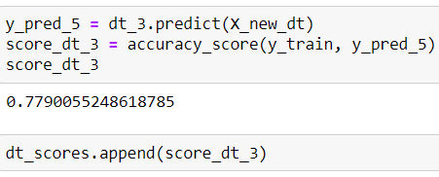
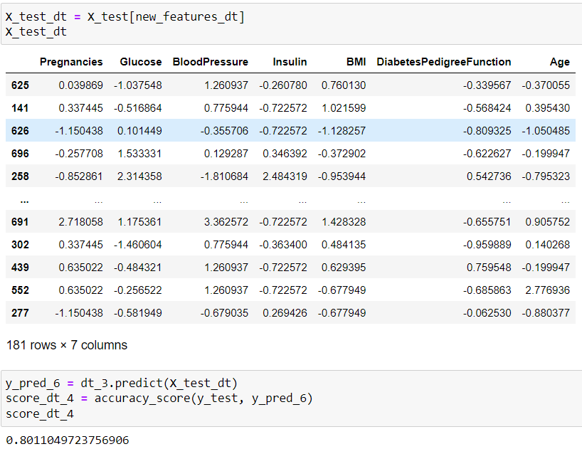
Final Model:
Training Scores:
Testing:

Slide 30
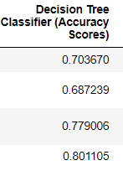
Final Scores:

Slide 31

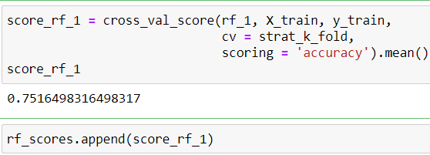
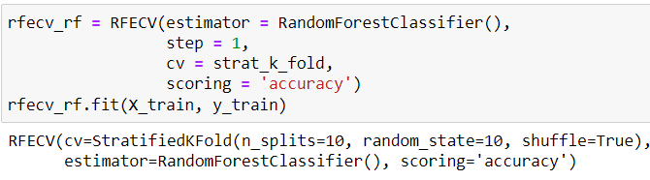
4.Random Forest Classifier
Initial Model:
Initial Score:
Dimensionality Reduction:

Slide 32
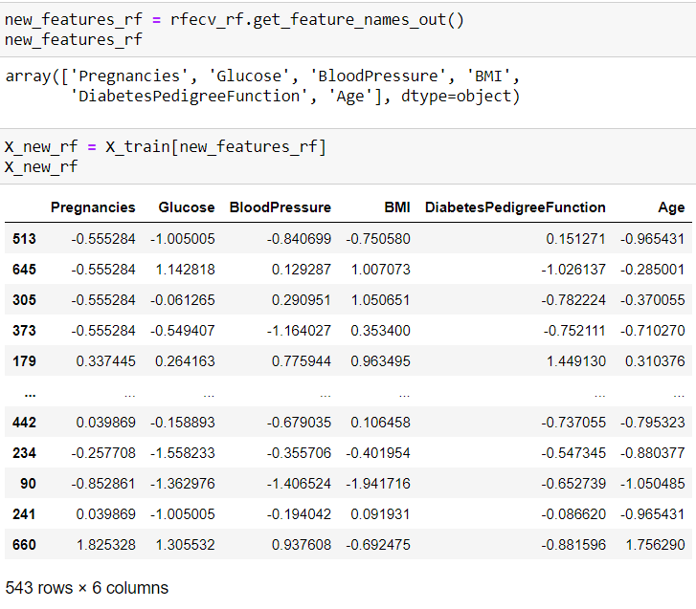

Slide 33
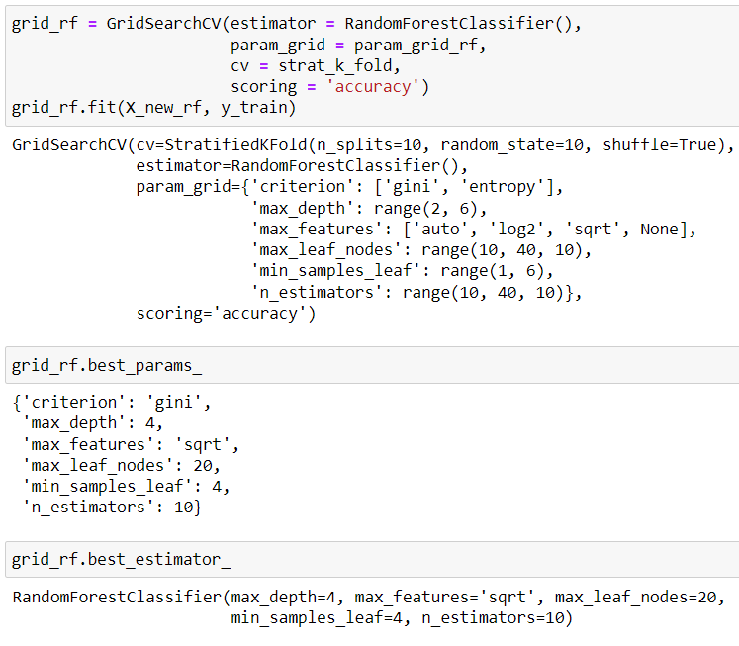
Hyper Parameter Tuning:

Slide 34
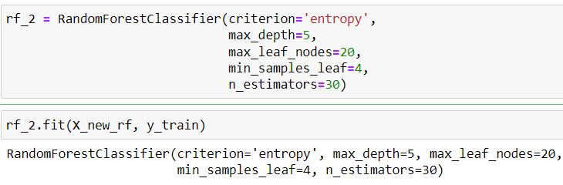
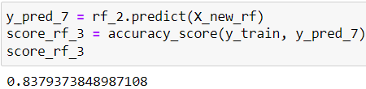
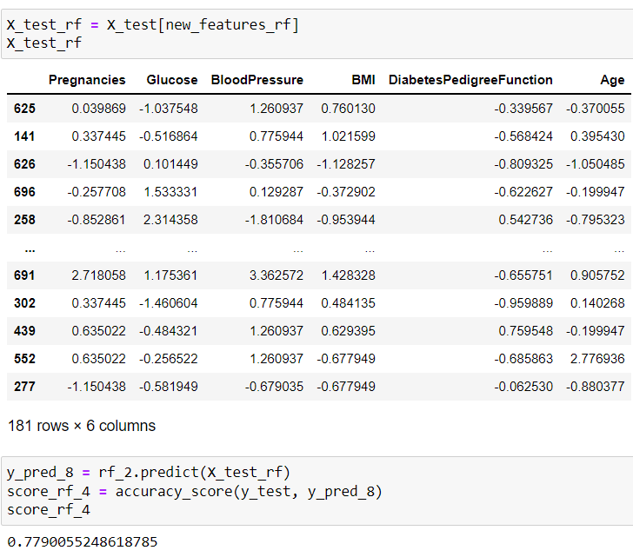
Final Model:
Training Scores:
Testing:

Slide 35
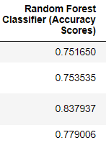
Final Scores:

Slide 36

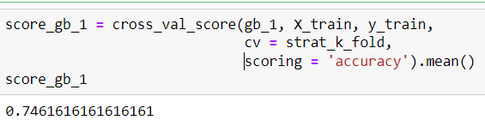
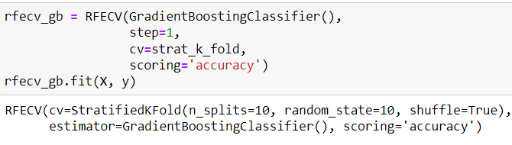
5.Gradient Boosting Classifier
Initial Model:
Initial Score:
Dimensionality Reduction:

Slide 37
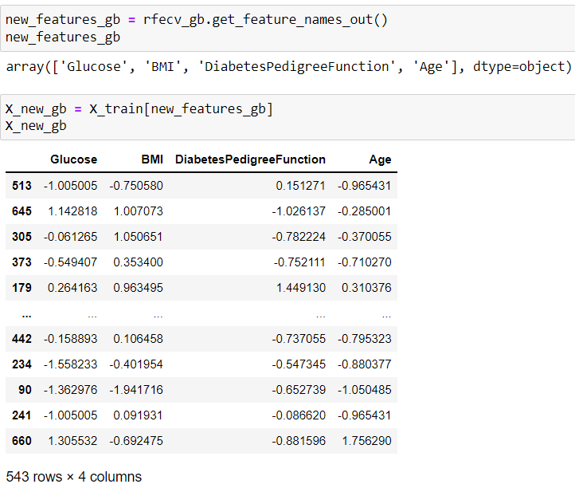

Slide 38

Hyper Parameter Tuning:

Slide 39


Final Model:
Training Scores:

Slide 40


Testing:
Final Scores:

Slide 41


6.Extra Trees Classifier
Initial Model:
Initial Score:
Dimensionality Reduction:

Slide 42


Slide 43

Hyper Parameter Tuning:

Slide 44


Final Model
Training Scores:

Slide 45


Testing:
Final Scores:

Slide 46

Conclusion
Thus, by enlisting each model considered and the corresponding Accuracy Scores.

Slide 47
Decision Tree Classifier performed very well on training data with accuracy of 0.779006.
And the performed extremely well on testing with accuracy of 0.801105.
Logistic Regression seems as good as logistic regression with training score of 0.777164 and testing score of 0.790055
Thus Decision Tree Classifier is the best model to be chosen for prediction of presence of Diabetes based on data by National Institute of Diabetes and Digestive and Kidney Diseases.

Slide 48
Thank You

